Slide 1


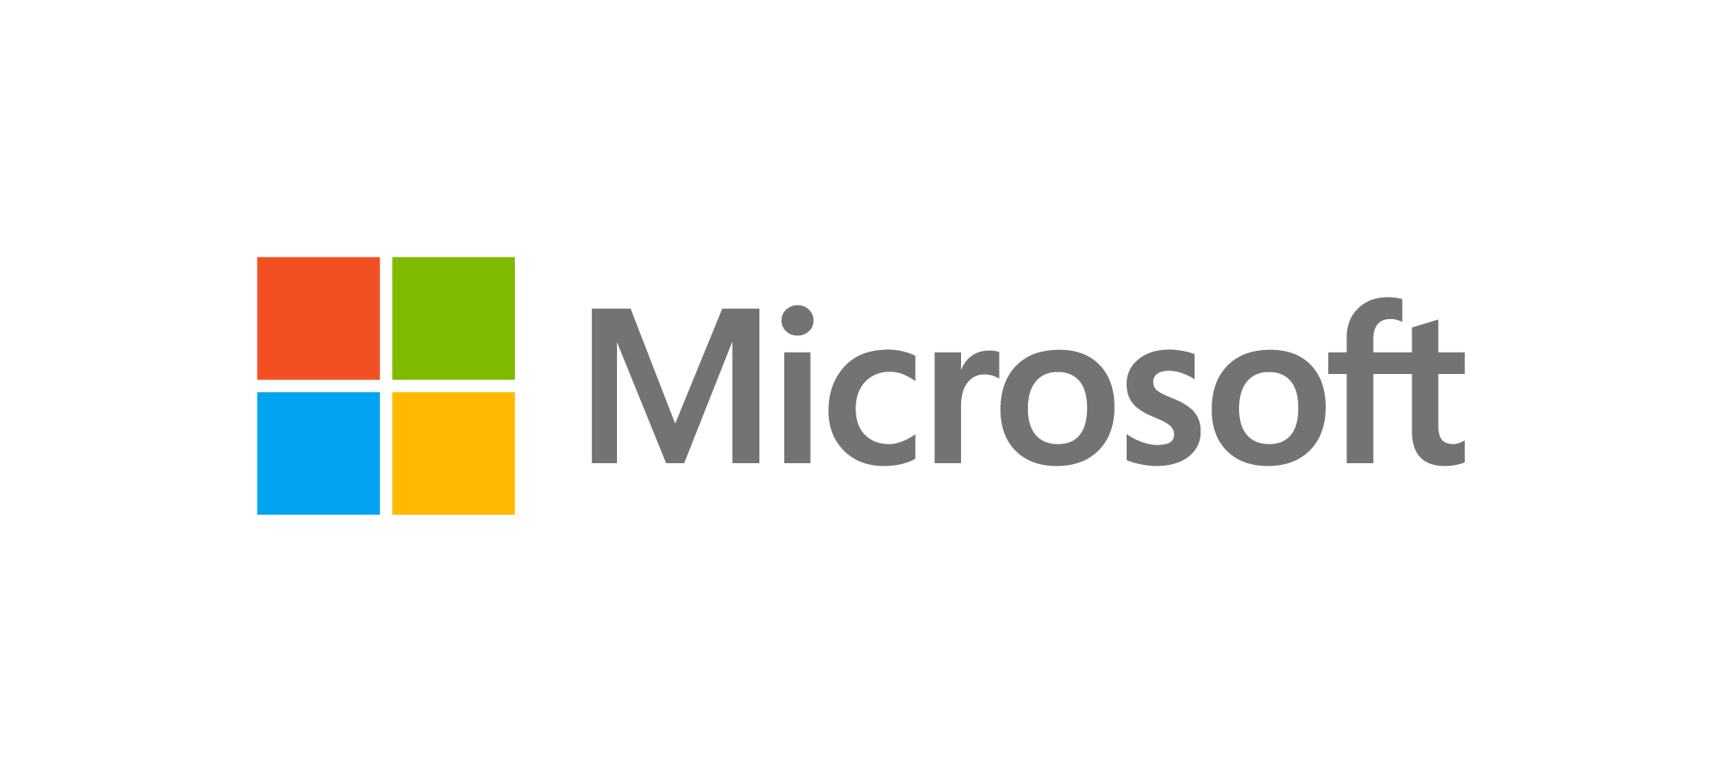
Open Education Analytics
modern data estate for education

Slide 2

Dispersed data prevents strategic use of data and AI
For the Use Cases You Need
Personalized Learning Pathways
Real Time Data Dashboards
Open Data for Research and Evaluation
Identifying and supporting at risk students
State, Province and National Longitudinal Reporting
Notes:
In most education systems today, you have different data sources in a lot of disconnected systems. Collecting that data and landing it in one place, where your teams can work with it efficiently and precisely, is really challenging with older data warehouse and data model approaches– If you could do this, however, it could enable many key education scenarios, from personalizing learning pathways; to real time reporting to schools, departments, educators, learners, and parents or guardians; to accelerating research and evaluation on programs and interventions. It could also unlock the power of AI and provide more efficient state and national longitudinal reporting. It all starts with setting up the modern data estate.

Slide 3

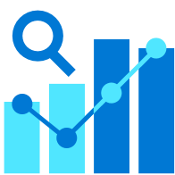
Datasets are dispersed and poorly governed
EDUCATION’S CHALLENGES WITH DATA AND AI
Concerns over data privacy and ethical use of AI
Low organizational expertise in learning analytics and AI
Getting started is overwhelming

Slide 4


What is Open Education Analytics
OPEN EDUCATION ANALYTICS TECHNICAL RESOURCES AND COMMUNITY
ROLE AND TECH TRAINING: CAPACITY-BUILDING ON LEARNING ANALYTICS AND AI
PRINCIPLES OF RESPONSIBLE DATA AND AI APPLIED TO EDUCATION
SHARED LEARNING ANALYTICS AND AI USE CASES IN COMMUNITY
Notes:
We see Open Edu Analytics as a natural next step in customers’ journey to Learning Analytics and AI. And we have many large education system customers who are interested in taking this journey, including state departments of education and national ministries of education around the world.
The great news for partners is that there are many opportunities to participate in this ecosystem, and we are depending upon you to make it scale and grow the assets.
Starting from the thousands of customers adopting SDS and Education Insights, there are many steps in the journey where ISVs, System Integrators, data science and AI companies, and Training providers will be needed to build this Open Education Analytics ecosystem.

Slide 5

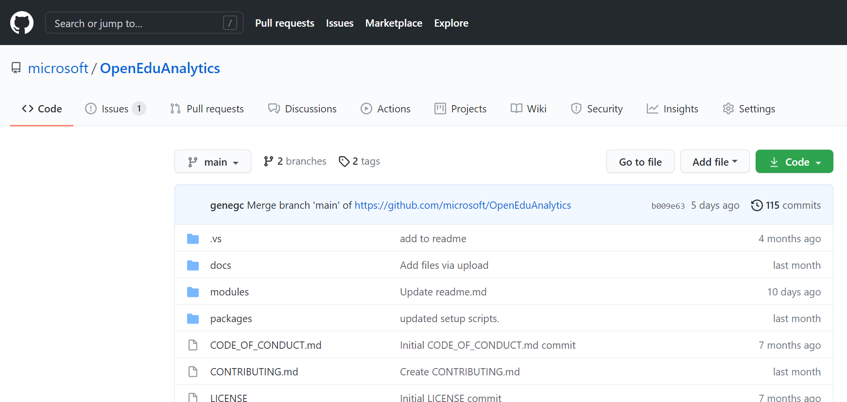
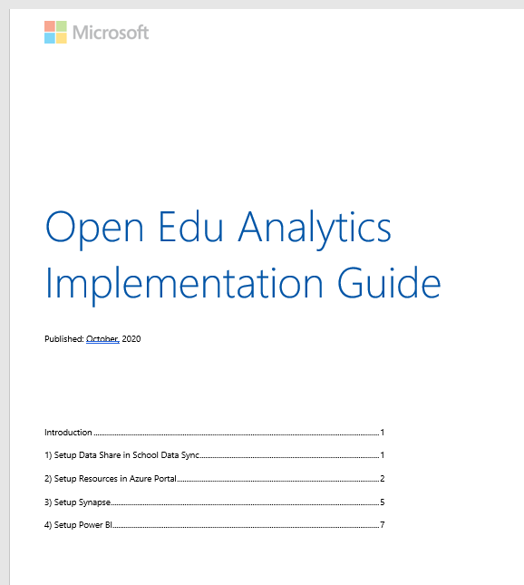
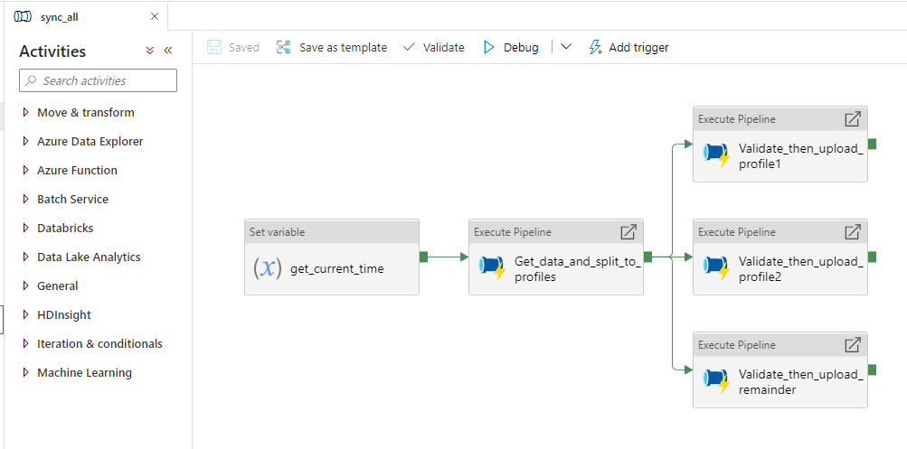
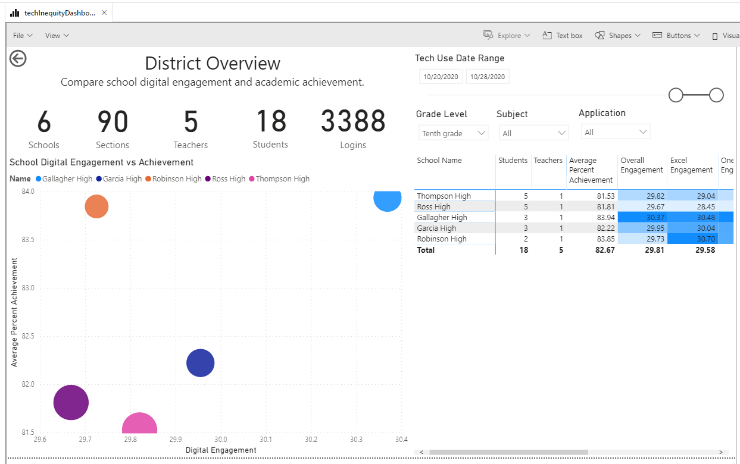
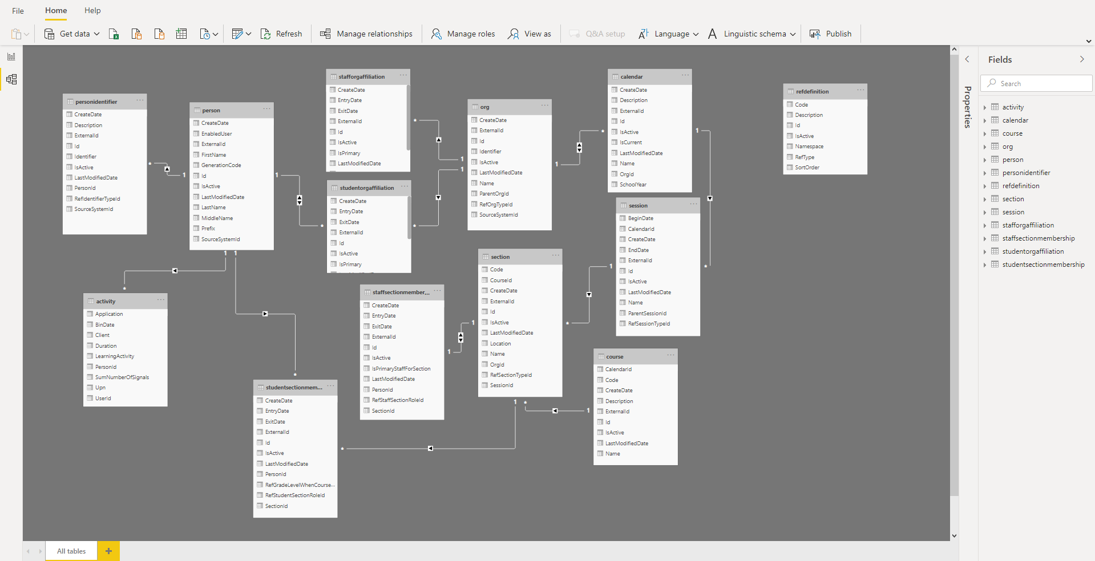
Open resources on GitHub: Pre-made data pipelines, scripts, analytics notebooks, test data, dashboards, data models, and reference architecture

Slide 6
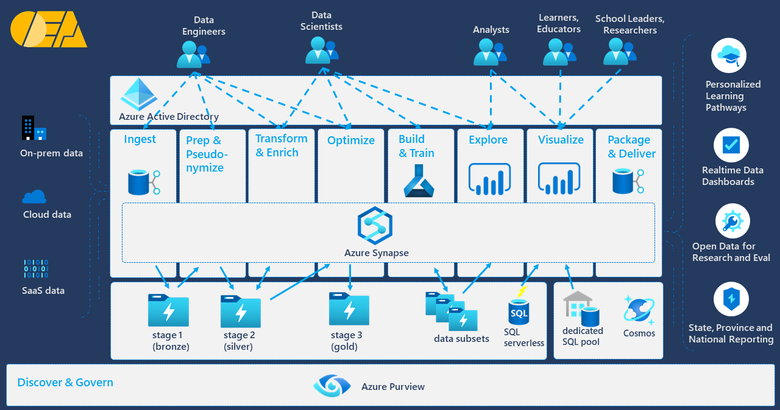
Open reference architecture for establishing the modern data estate using Azure cloud data and AI services
Notes:
With Open Education Analytics, we are providing a reference architecture for the Modern Data Estate, and a reference implementation that means you don’t have to build everything yourself. You can:
Provision and govern a modern data estate within your own Azure subscriptions,
Use Synapse studio to facilitate the process of data extraction, ingestion, preparation, transformation, and enrichment
Use Azure Active Directory to enforce role-based-access-control to the data for security and privacy,
Use powerful data visualization tools, such as Power BI, to explore and present data through flexible dashboards
Use modern data science tools, such as Auto ML, that enable high speed research over big data
All built on the foundation of Azure Data Lake storage, which means significant cost efficiencies.

Slide 7
Solving the problem with an open community
standards
best practices
rapid iteration/
emergent design
modern tech
ecosystem / global community
data standards (at rest, in transit)
process standards (ethical use, dev cycle, testing)
ethical use
ref architecture, ref implementation
dev process (dev cycle, testing strategy, releases)
training
sandbox env, test data sets
evolve schema
emphasis on build-learn-improve
cloud-based (low cost, infinitely scalable)
easy setup (setup scripts, infrastructure as code)
easy maintenance (auto-scale, monitoring)
easy to extend (extensible arch, add-on modules)
customers, SI’s, ISV’s, standards bodies, policymakers
focus on sharing, collaboration
Notes:
It starts with the edtech ecosystem. We need to collaborate and crowd-source the foundational pieces that allow us as an industry to operate and differentiate at a higher level
The modern tech is a game changer. Everything is far easier and cheaper than it’s ever been, if you’re using the right tools.
Real solutions are built through iterations, not endless design and planning. Rapid iterations allow teams to keep moving forward over time, capturing value today as well as creating more value tomorrow.
Patterns naturally emerge from iterations; leading to common best practices.
Standards are the codification of everything we’ve learned as an industry. Data standards are the pinnacle – they are the answers we’ve derived over time. We can and should use them from the start wherever possible, but shouldn’t expect the data standards to have all the answers we need to begin with. The current state of our edu data standards is not great – we have to derive the answers we need and accelerate the development of those standards.

Slide 8
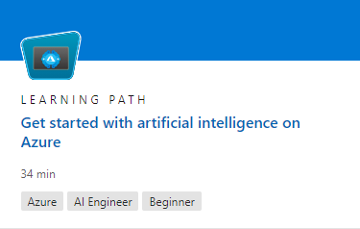
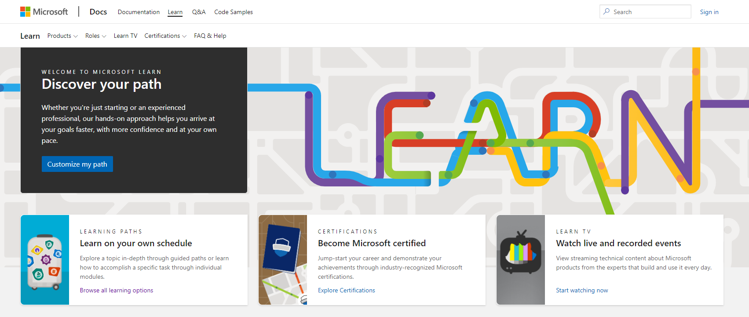
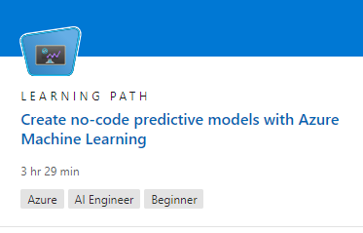
ROLE AND TECH TRAINING: CAPACITY-BUILDING ON LEARNING ANALYTICS AND AI

Slide 9
Define the problem with key groups
Define data needed and inclusively collect data
move datasets to cloud, with security and privacy
develop and test AI models for reliability and fairness
pilot AI experiences, iterate with feedback
document analytical methods for transparency
Monitor AI system for accountability
PRINCIPLES OF RESPONSIBLE DATA AND AI APPLIED TO EDUCATION

Slide 10
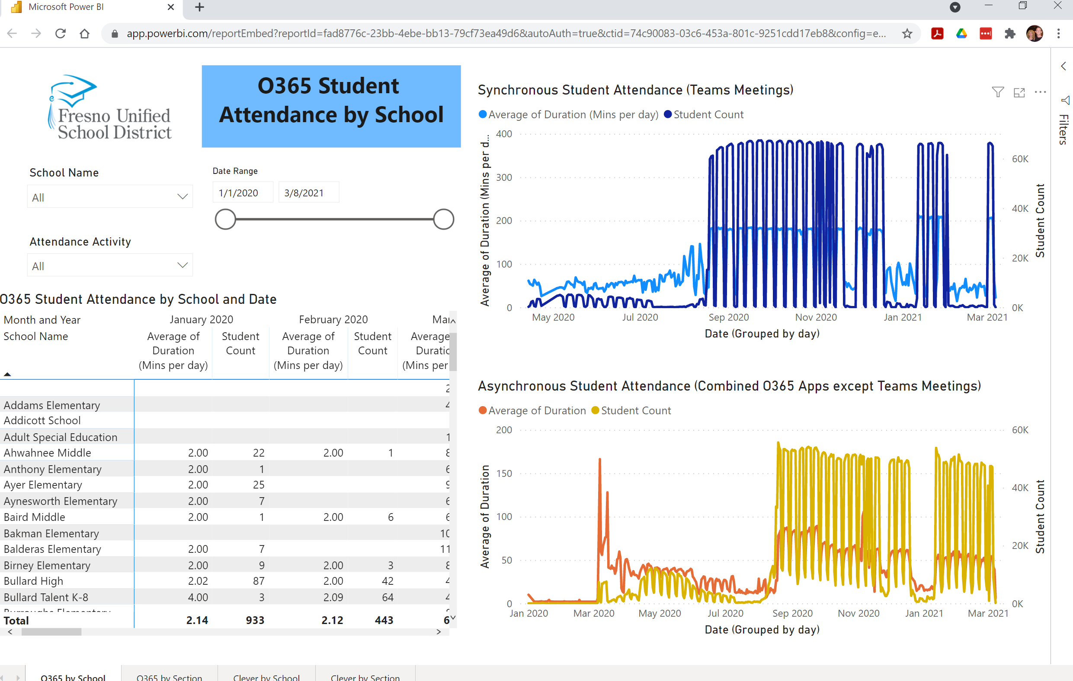

Digital Attendance Dashboard
SHARED LEARNING ANALYTICS AND AI USE CASES IN COMMUNITY

Slide 11
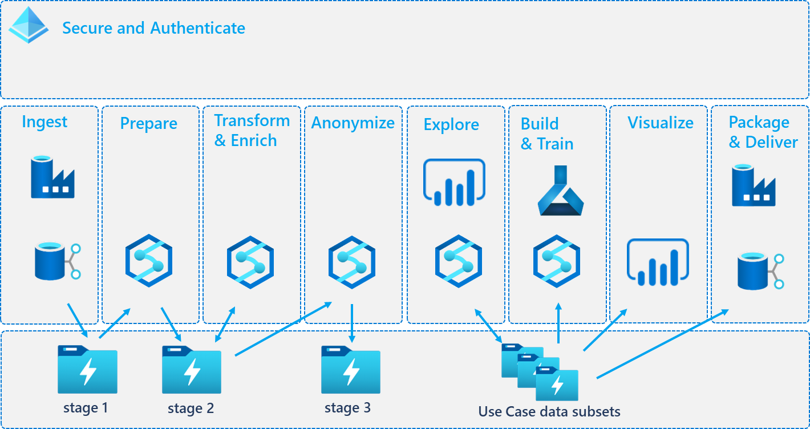
Open Education Analytics Community
enabling many types of education data…
…to be used for many different scenarios
Building A Global Analytics Ecosystem
Notes:
Perhaps most importantly, Open Learning Analytics is a community. With all the disparate data sources and systems that education systems use today, we need a global community developing and sharing data pipelines from different data sources, learning analytics methods, data visualization templates and AI approaches to enable the variety of scenarios that education systems and learners need.
With the Open Learning Analytics reference architecture at the center, we hope that education systems everywhere will develop and contribute the components they build, so that other education systems in the community can share and re-use them, without having to build everything in isolation. We see this community as the way to build a global learning analytics ecosystem that can finally unlock the potential of data to improve learning everywhere.

Slide 12
Join Open Education Analytics at
https://github.com/microsoft/OpenEduAnalytics.

